Slide 1
Voyage in Canon Ocean so far..
Guruchethan D P

Slide 2
Things I have learnt
PERL SCRIPTING
UNIX SHELL COMMANDS
VHDL

Slide 3
PERL
Perl Datatypes
Scalars($), arrays(@), hashes(%)
Array operations
Push, pop, unshift etc.
If…else
Loops
While, for, until, foreach etc.
Operators
Logical, arithmetic, string etc.
Subroutines
File I/O
Thanks to:
Tutorials point(http://www.tutorialspoint.com/perl/)
Perl Maven (http://perlmaven.com/perl-tutorial)

Slide 4
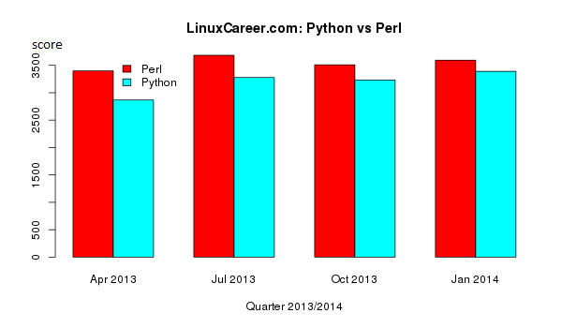
Perl vs Python
Courtesy: linuxcareer.com

Slide 5
Makefiles
A way of associating short names, called targets, with a series of commands to be executed when the action is requested.
Target: dependencies
<Tab> shell_commands
Very helpful if there are many files and many dependencies in the project.
How does it work?
If the time stamp of the dependencies is newer than that of the target, command is executed.

Slide 6
PERL exercises
Ex1
Ex1a
2 .txt files containing a list of names
Write a script to find the union of these files and write to the output file with the names sorted in the alphabetical order.
Ex1b
2 .txt files with the names and corresponding marks.
Find the union and write to the output file with the highest marks in the beginning
Ex2
Ex2a => same as ex1a but files will be excel files instead of txt files
Ex2b => same as ex1b but files will be excel files instead of txt files
Ex3
Write the makefile with 1a,1b as one target and 2a,2b as two targets

Slide 7
Unix shell commands
Since I’m new to Unix OS, got an opportunity to operate with the Unix system.
Got an opportunity to learn and use some Unix utilities like vi editor, makefiles etc.

Slide 8
VHDL and Verilog
These are the different hardware description languages used to describe a circuit.
I had learnt Verilog as part of my college curriculum but VHDL was new to me.
Learnt VHDL
Ref: Circuit design with VHDL by Volnei Pedroni
Designed and tested some basic modules like n-bit counter, mux, dff etc.

Slide 9
VHDL
Code structure
Entity, architectures
Data types
Bit, integer, real, std_logic etc
Concurrency
Outside process, functions or procedures
When, when..else, with/select/when
Sequential
Within process, functions or procedures
If, wait, case, loop
Signals and variables
Packages and components
Port map, generic map.

Slide 10
Problems faced
Could not install Perl cpan modules.
Was new to Linux environment.
Could not write TestBench and simulate for initial few days.
I was finding it difficult to use the Cadence tool.

Slide 11
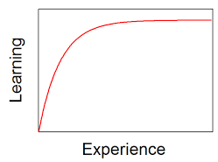
Learning curve..

Slide 12
Q & A
THANK YOU

